Slide 1

Data Modelling
Dr. Rakhee Chhibber

Slide 2
Agenda
• Concepts: Tables, relationships, keys – ER Diagrams
• Star schema vs. flat tables
• Creating relationships
• Cardinality and cross-filter direction
• Calculated columns vs. measures

Slide 3

Introduction
Data modeling is the process of defining how data is stored, connected, and analyzed to answer business questions accurately.
Data modeling is the process of creating visual representations of the connections between data structures, with information about the individual attributes contained within those data structures.

Slide 4
Core Concepts: Tables, Keys, and ER Diagrams
Tables & Entities: Represent real-world "things" (e.g., Students, Orders) and their details, known as attributes.
Keys:
  Primary Key (PK): A unique identifier for every row in a table.
  Foreign Key (FK): A column that links to a PK in another table to establish a relationship.
ER Diagrams: Visual maps showing how these entities relate to one another using arrows and link.

Slide 5
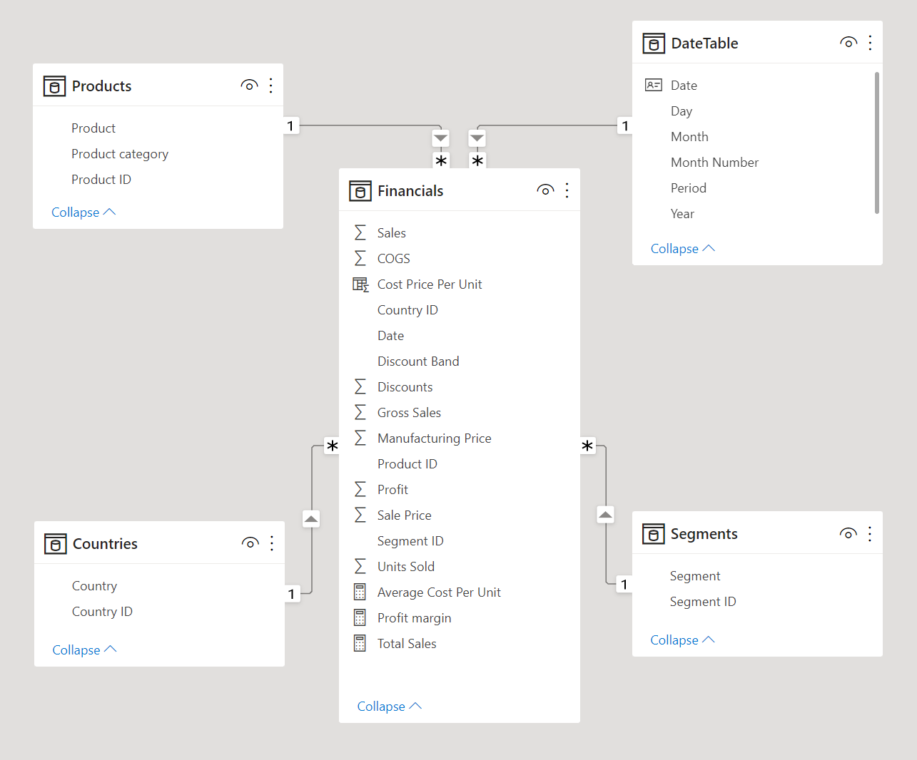
Star Schema
A star schema is made up of a central fact table with multiple dimension tables branching off of this fact table, much like the appearance of a star. Ideally, it is good practice to have only one fact table in a data model

Slide 6
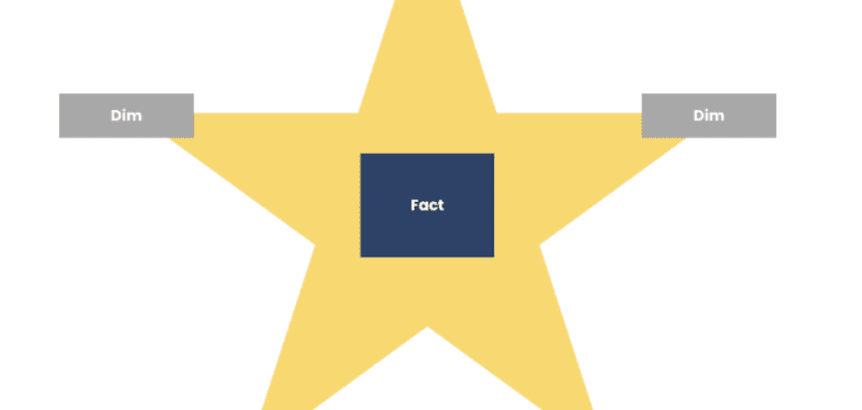

Slide 7
Fact tables
A fact table is made up of values that can be summarized and aggregated, as well as one or more keys that link to the dimension tables. The purpose of the key is to make connections between tables. If you have complex data models or large volumes of data, it is a good idea for the keys to be numeric values rather than text strings, as this can improve the performance of the model.
Fact tables should be very narrow and include as few columns as possible. Any columns that describe the features of a dataset, such as Product Name or Product Category, should be separated out of the fact table (if not already separated in the data warehouse) into their respective dimension tables. This process is called normalization of the data, and the goal is to avoid repetitiveness.

Slide 8
Dimension Table
Dimension tables describe the features of the dataset, where features are logically grouped together in separate tables to avoid bloating a single table or making it difficult to create relationships. The dimension tables should contain unique values for the features they are describing, and their columns will be responsible for filtering or grouping the data in the Power BI report.

Slide 9
Snowflake Schema
An extension of the star schema is the snowflake schema. In this approach, the dimension tables are further divided if a feature has any further categories or subcategories. In our case, we have a Products table that contains the Product ID, Product Name, and Product Category. In a snowflake schema, this Products table will only contain the Product ID and the Product Name, while the Product Category would be further divided out into it’s own table with a Product Category ID and Product Category.

Slide 10
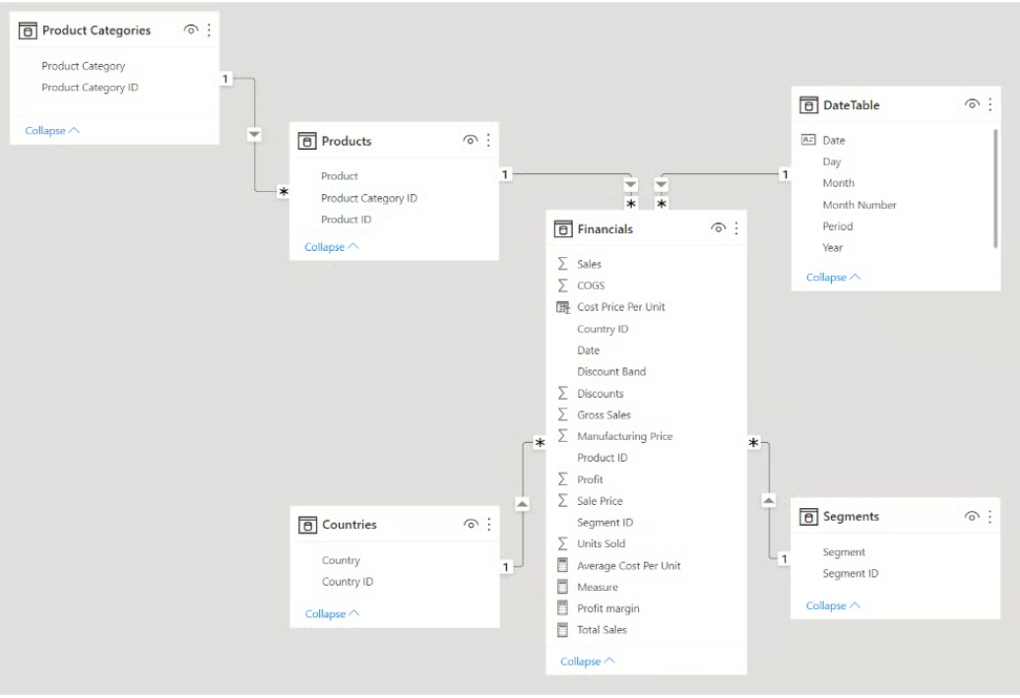

Slide 11
Star Schema vs. Flat Tables
Star Schema: A central Fact Table (numerical data like sales) surrounded by Dimension Tables (descriptive data like products or dates). It is the recommended best practice for tools like Microsoft Power BI because it optimizes query speed and simplifies reporting.
Flat Tables: Consolidate all data into a single, wide table. While simple to build for small datasets, they lead to data redundancy and can slow down performance as data grows.

Slide 12
Relationships and Cardinality
Relationships allow tables to "talk" to each other based on common columns.
Cardinality: Defines the nature of the link.
  One-to-Many (1:*): The most common type; one record in a dimension table (e.g., one customer) links to many records in a fact table (e.g., many sales).
  Many-to-Many (:): Occurs when multiple records in both tables relate to each other.
  One-to-One (1:1): Each record in one table connects to exactly one record in another.

Slide 13
Thank You

